Slide 1
Modeling leaf responses to soil nitrogen availability
Nick Smith (Texas Tech University; nick.smith@ttu.edu)
Evan Perkowski, Lizz Waring, Christy Goodale, Dave Frey, Qing Zhu, Bill Riley, Trevor Keenan

Slide 2
The typical paradigm
Soil nitrogen ∝ Leaf nitrogen ∝ V_{cmax}
N
N

Slide 3
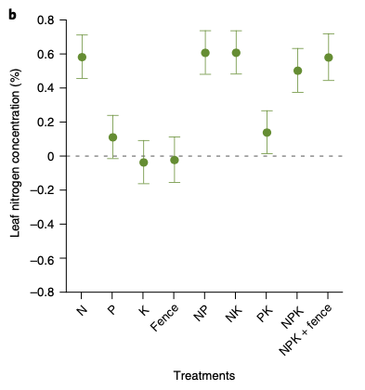
The typical paradigm
Soil nitrogen ∝ Leaf nitrogen ∝ V_{cmax}
Firn et al. (2019)

Slide 4
The typical paradigm
Soil nitrogen ∝ Leaf nitrogen ∝ V_{cmax}
Walker et al. (2014)

